Slide 1


Welcome to
St. Paul & St. Timothy’s Catholic Infant School
Reception Induction 15th May 2025
Love, Learn, Believe, Achieve in the Spirit of Jesus

Slide 2
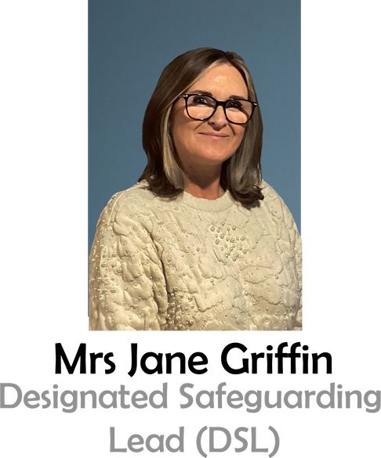

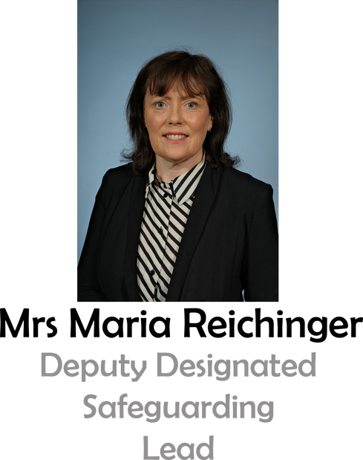
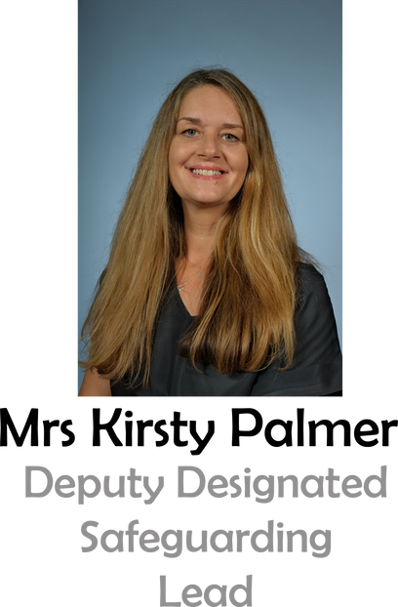
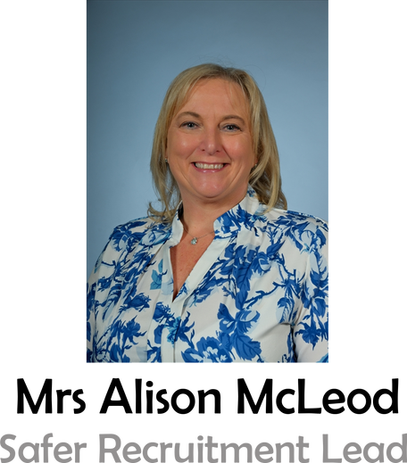

Senior Leaders
Mrs Jane Griffin
Headteacher
Mrs Reichinger
Deputy Headteacher
Mrs Palmer
Assistant Headteacher & SENCo
Mrs McLeod
School Business Manager
www.stpaulandsttimothys.com
Love, Learn, Believe, Achieve in the Spirit of Jesus
Love, Learn, Believe, Achieve in the Spirit of Jesus

Slide 3

The Importance of Attendance
  Children who attend school regularly make better progress socially and academically.
  Missing even a few days can affect a child's confidence and learning.
  Good habits start early—help your child develop a positive attitude towards school.
  School starts at ... – arriving on time helps your child settle into the day calmly.
  First Day Response: Please inform the school by 8:00 a.m. if your child is absent. If we do not hear from you, our attendance officer will call to ensure your child's safety.
  Holidays during term time cannot be authorised (except in exceptional circumstances).
www.stpaulandsttimothys.com
Love, Learn, Believe, Achieve in the Spirit of Jesus

Slide 4
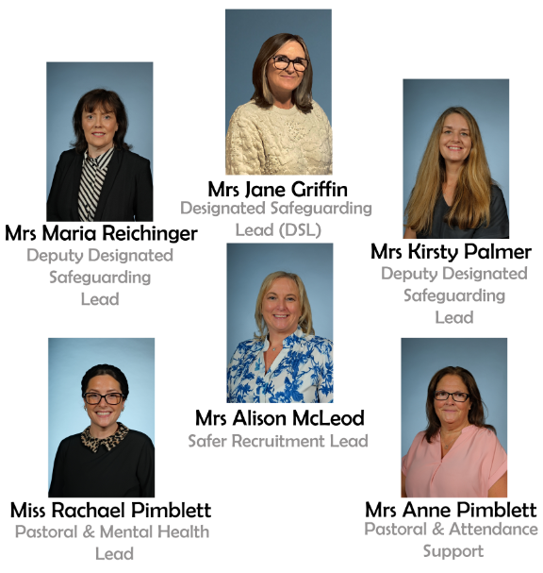


Safeguarding
All staff are fully trained in safeguarding policies and procedures.
Our Designated Safeguarding Team is available as a point of contact for any concerns you may have.
www.stpaulandsttimothys.com
Love, Learn, Believe, Achieve in the Spirit of Jesus

Slide 5
Key Polices and Practices
Child Protection - Strict procedures in place for identifying and responding to concerns.
Health and Safety - Regular risk assessments and emergency drills.
Online Safety - Teaching children safe internet practices and monitoring digital practices.
Open Door Policy - Parents are encouraged to raise any concerns directly with us.
Operation Encompass
www.stpaulandsttimothys.com
Love, Learn, Believe, Achieve in the Spirit of Jesus

Slide 6

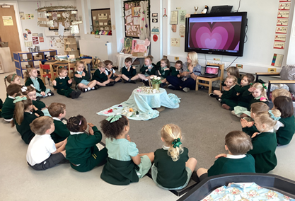
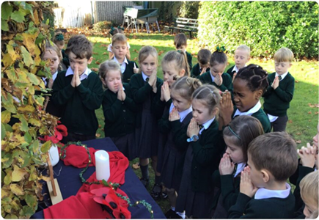
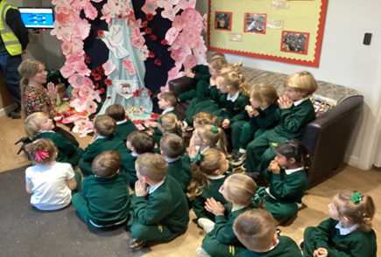
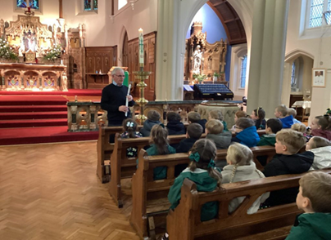
Catholic Life and Mission
St Paul and St Timothy’s Catholic Infant School aims to be a place where the Gospel values of our Lord Jesus Christ are taught, lived and experienced, where prayer and celebrations are integral to life and where religious growth and development are stimulated within the total curriculum to which all can contribute and from which all can gain.
www.stpaulandsttimothys.com
Love, Learn, Believe, Achieve in the Spirit of Jesus

Slide 7
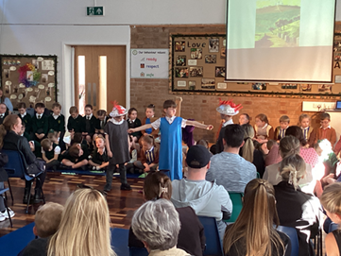
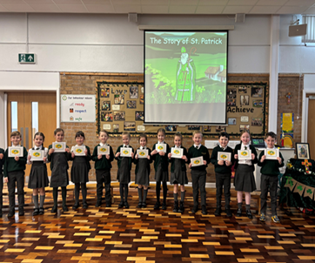

Catholic Life and R.E.
Our mission statement, ‘Love, Learn, Believe Achieve’ is displayed all over the school and is the foundation of our daily life.
R.E lessons are taught in class. We follow the Religious Education Directory- ‘To Know You More Clearly.’
The children participate in daily prayer and liturgy and gather together for assemblies as a year group or as a whole school.
As a Catholic School, we attach the greatest importance to Religious Education in the life of our School.
This not only applies to specific R.E. lessons but in the everyday interaction of school life, assemblies, meal times, play times and all the relationships that exist within
St. Paul and St Timothy’s.
We teach tolerance and respect for other faiths, races and cultures.
www.stpaulandsttimothys.com
Love, Learn, Believe, Achieve in the Spirit of Jesus

Slide 8
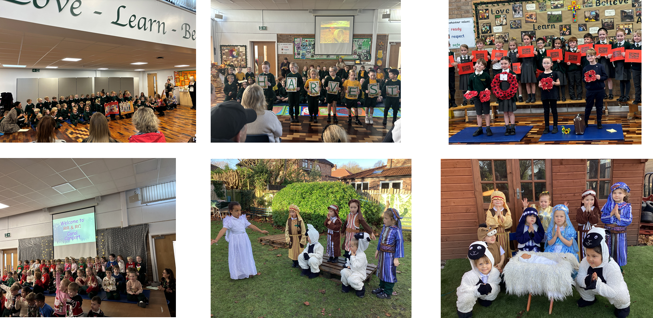
Celebrating our Faith
www.stpaulandsttimothys.com
Love, Learn, Believe, Achieve in the Spirit of Jesus

Slide 9
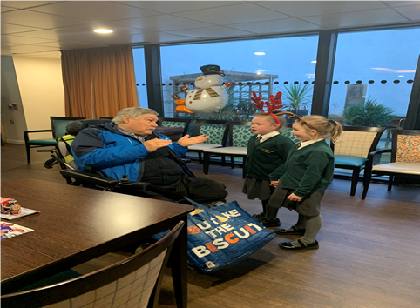
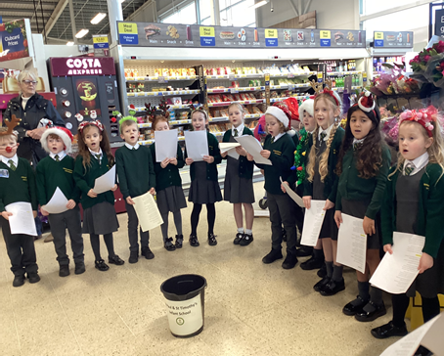

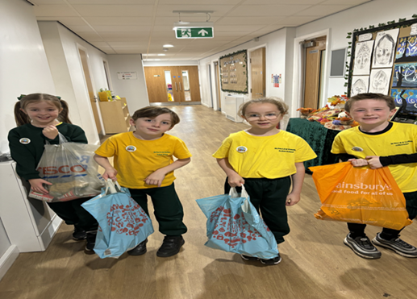
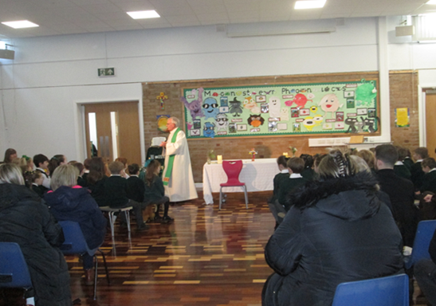
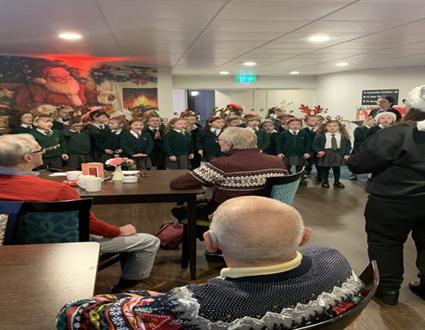
Faith in Action
Supporting our Local Community
www.stpaulandsttimothys.com
Love, Learn, Believe, Achieve in the Spirit of Jesus

Slide 10

Catholic Social Teaching
Catholic Social Teaching (CST) is rooted in Scripture and it guides us on how to live out our faith in the world.
There are seven principles of Catholic Social Teaching:
  Dignity
  Solidarity
  The common good
  The option for the poor - Putting people most in need first
  Peace
  Creation and environment
  The dignity of work and participation
Our faith calls us to love God and to love our neighbours in every situation, especially our sisters and brothers living in poverty.
www.stpaulandsttimothys.com
Love, Learn, Believe, Achieve in the Spirit of Jesus

Slide 11
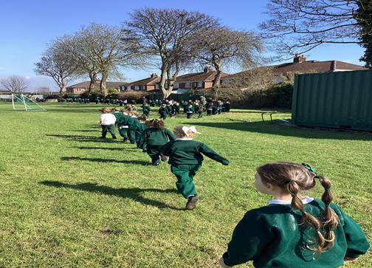

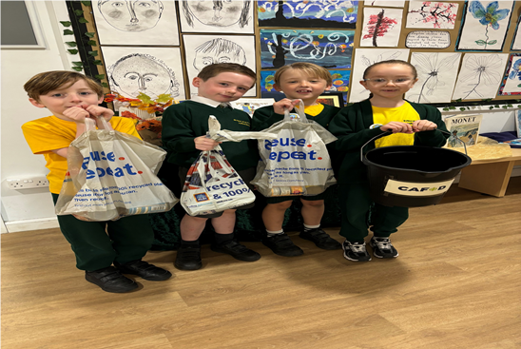

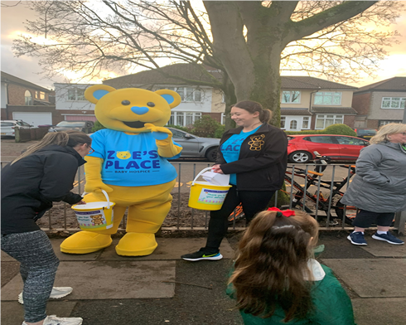

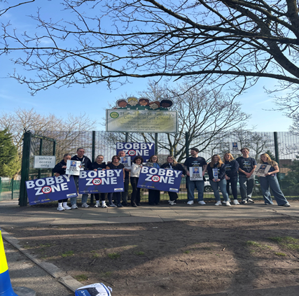
Charities We Support
www.stpaulandsttimothys.com
Love, Learn, Believe, Achieve in the Spirit of Jesus

Slide 12

Charities We Support
www.stpaulandsttimothys.com
Love, Learn, Believe, Achieve in the Spirit of Jesus

Slide 13

SEND and Inclusion
  How we can work together to support a smooth and successful transition.
  Please tell us about your child!
  Support from Nursery setting
  Play plan
  S&LT
  Community Paediatrics
  Neurodevelopmental Pathway
  Trauma or adverse childhood experiences
  Outside agency support (Educational Psychology, SENISS, Purple Circle, OT etc.)
  Medical or Health needs.
www.stpaulandsttimothys.com
Love, Learn, Believe, Achieve in the Spirit of Jesus

Slide 14
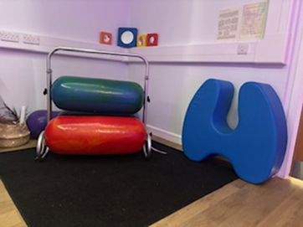
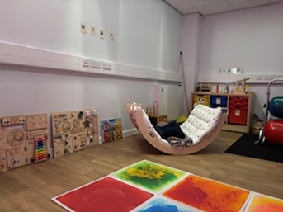
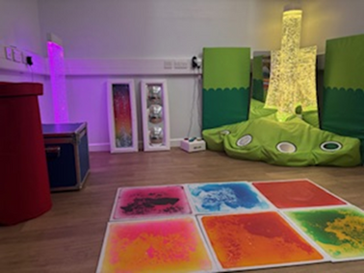
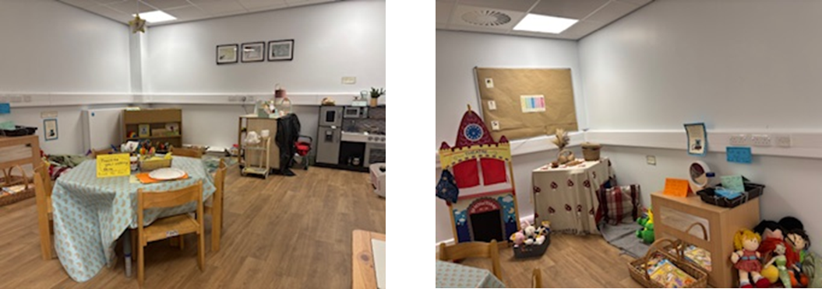

Attachment & Trauma Sensitive School
Therapeutic classrooms are welcoming, safe, inviting environments that cultivate belonging and learning through their design.
They calm stress hormones and increase feelings of emotional safety, whilst meeting the emotional and mental health needs of the children.
Therapeutic classrooms include calm spaces and flexible seating and allow children to work and play where they feel most comfortable.
Therapeutic classrooms are flexible spaces that promote communication and engagement, they are underpinned by evidence based research.
Our Sensory Room
Our Cosy Corner (Therapeutic Classroom)
www.stpaulandsttimothys.com
Love, Learn, Believe, Achieve in the Spirit of Jesus

Slide 15
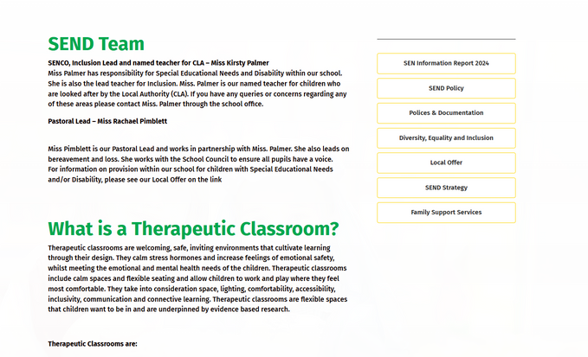
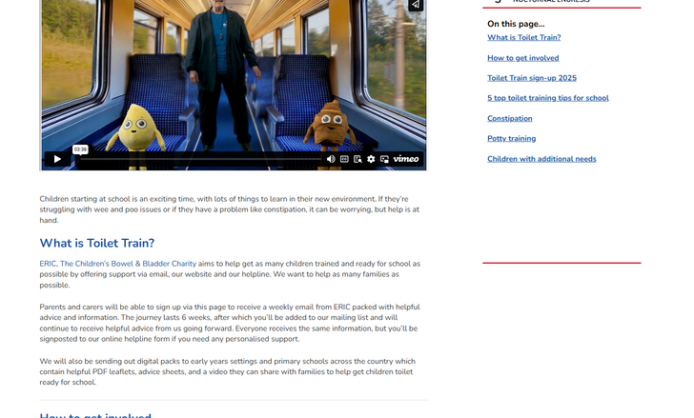


Useful Links and Support for Parents
Our School Website - https://stpaulandsttimothys.com/send/
Eric – starting school https://eric.org.uk/all-aboard-the-toilet-train-get-ready-for-school/
Inclusion and diversity -
IQM report link https://stpaulandsttimothys.com/equality/
Liverpool Parenting Newsletter https://sway.cloud.microsoft/08yxPiIEVp8SLduY?ref=Link
www.stpaulandsttimothys.com
Love, Learn, Believe, Achieve in the Spirit of Jesus

Slide 16
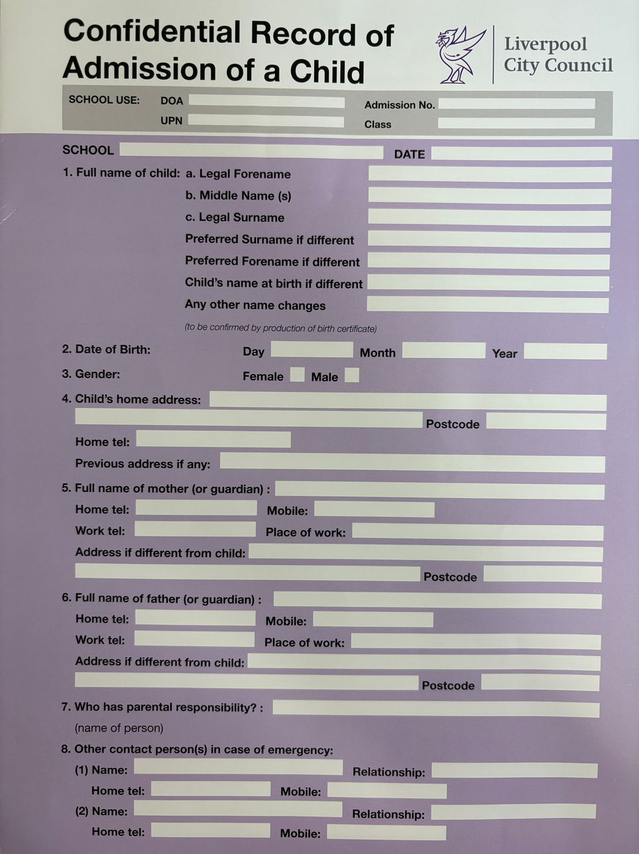
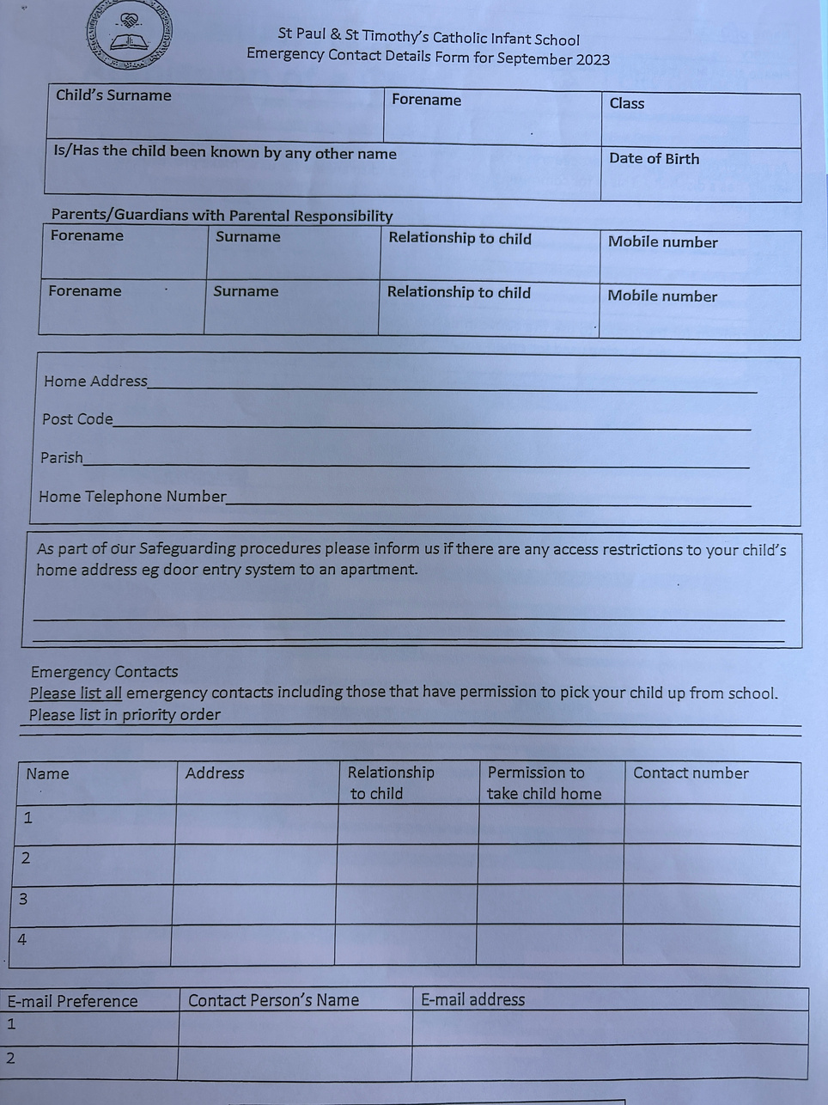
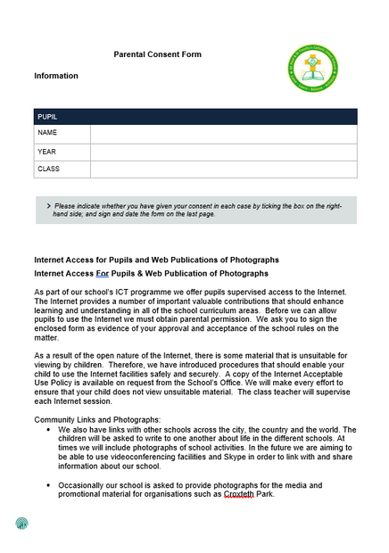
Information Packs
Forms:
  Confidential Admission Form
  Consent Forms
  School Meals
  Snack and Milk
Complete and return forms by 21st May.
Emergency Contacts - Any changes, let us know
  List in preference.
  Include people who will be able to pick up your child.
  Please call if someone different is picking up your child.
www.stpaulandsttimothys.com
Love, Learn, Believe, Achieve in the Spirit of Jesus

Slide 17
School Meals and Pupil Premium
School Meals
  Our School dinners are healthy, nutritious and cooked fresh.
  Allergies and special dietary requirements can be reviewed with the cook.
  All children can receive a meal free of charge.
Pupil Premium
If you receive eligible benefits we can access additional funding.
Pupil Premium Funding entitles your child to
Free School Milk, Snack and Meals
You will be able to access to some free after school activities and school trips.
You will also receive Vouchers during the holidays to help buy food.
  You will need to apply through the citizen portal all information is in your pack and using the link below.
  https://liverpool.gov.uk/benefits/free-school-meals/
www.stpaulandsttimothys.com
Love, Learn, Believe, Achieve in the Spirit of Jesus

Slide 18




Communications
  ParentApps Connect - Parental Engagement and Consent Forms.
  Arbor - Payments, Consent Forms and Parents Meetings.
  School General Email - admin@spst.liverpool.sch.uk
  School Telephone Number - 0151 228 2114.
www.stpaulandsttimothys.com
Love, Learn, Believe, Achieve in the Spirit of Jesus

Slide 19
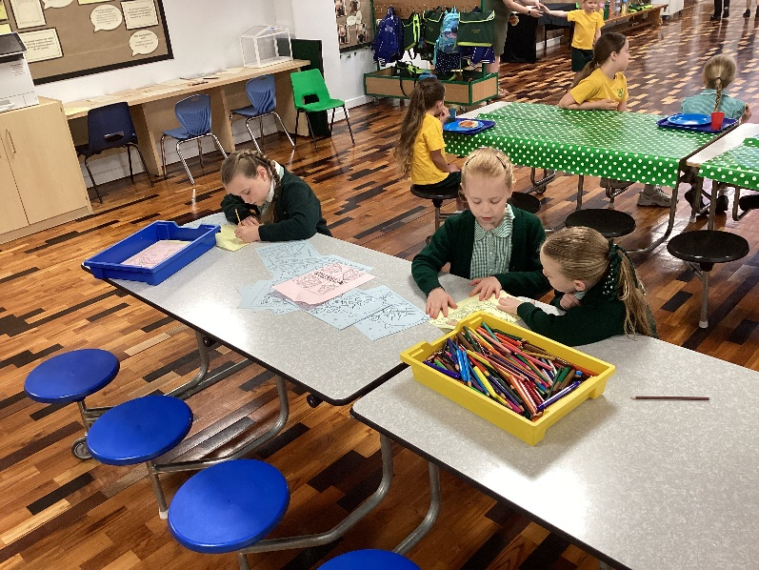
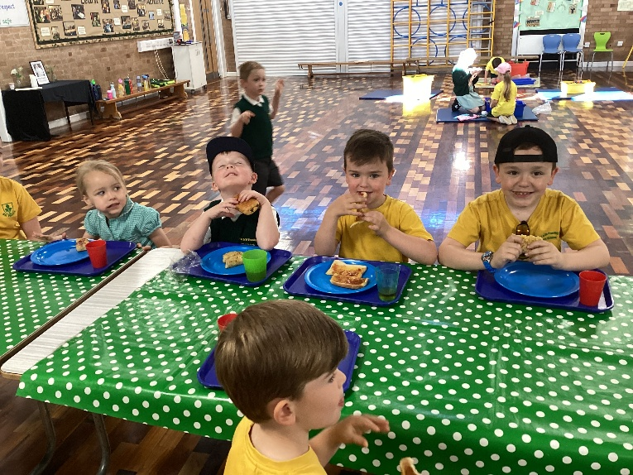
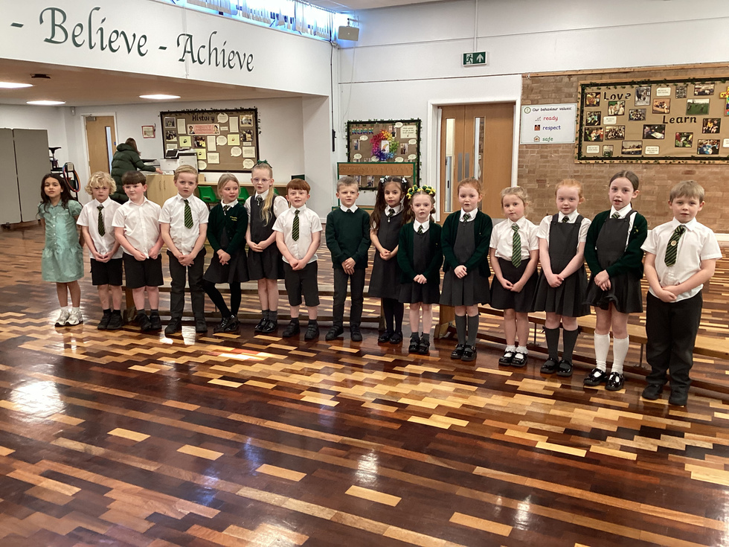
Breakfast & After School Clubs
Breakfast Club - Mon-Fri Starting at 8:00 am and finishing at 8:45 am.
The cost of the club is £4.00 per session.
Breakfast Menu includes (Toast, cereal, crumpets, yoghurts, milk and juice)
After-School Clubs:
  We provide a range of after-school clubs like Cookery, coding, sports, Spanish, Mad Science, art, craft, choir and outdoor.
There is no after-school provision, but there are local nurseries that provide this (West Derby Pre School or Kids in Bloom)
www.stpaulandsttimothys.com
Love, Learn, Believe, Achieve in the Spirit of Jesus

Slide 20
Transition into School Timetable
We have two opportunities for your child to come into Reception to meet staff and their class friends.
Time slots for these sessions will be given or sent to you.
Book Swap:
Your child will choose a school library book when they meet their teacher and can visit school to exchange books at the school foyer on a Wednesday morning during the Summer Term.
Session 1:
Communication with current settings:
Wednesday 21st May- “Stay n Play” in school for a half hour session. Your child will stay with you and have an opportunity to play and meet staff.
It is important that we gain a good understanding of your child before starting school. We will make contact with your child’s current setting to help us begin to build a picture of them .
Session 2:
Wednesday 2nd July- “Meet the teacher”. Your child will meet their new teacher and play in their new classroom. This is a 1 hour session. While the children are in the classroom you will be in the hall. During this time you will be given further information on how to help your child at home and about our Phonics Scheme.
September:
In September your child will attend for half a day for one week, either a morning or afternoon session.
A Profile meeting will be arranged with the class teacher to discuss your child and help a smooth transition into school.
www.stpaulandsttimothys.com
Love, Learn, Believe, Achieve in the Spirit of Jesus

Slide 21
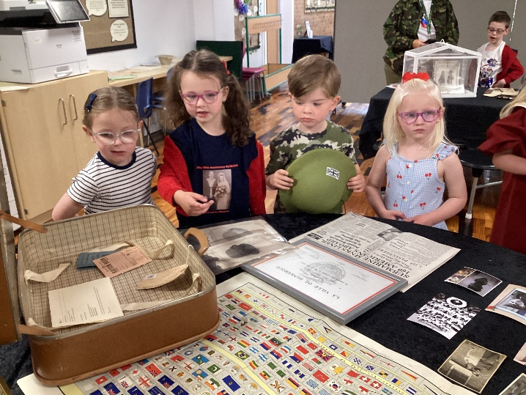
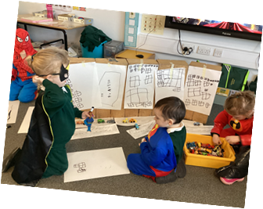
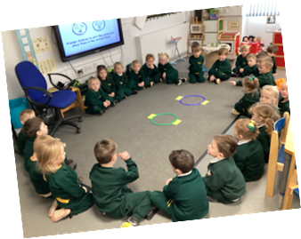
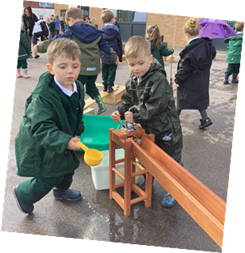
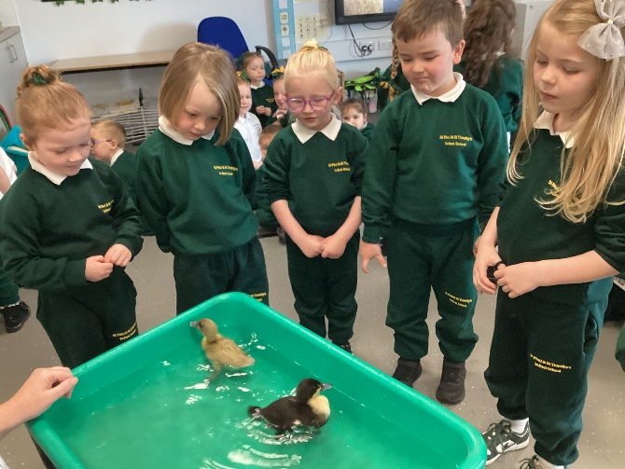
Reception Day
The Early Years Foundation Stage (EYFS) in Reception provides children with the opportunities to experience the best possible start to their education and future years at school.
Through grasping opportunities in child-initiated learning, partnered with direct teaching, children build a solid foundation to build on as they progress through their journey in KS1 education and beyond.
A typical day:
Short adult-led sessions daily:
•Prayer time
•Monster phonics sessions
•Maths Session
•Story time and singing rhymes
Our learning environment and invitations to play:
These are created around topics and interests of the children, where we encourage exploration and play.
The learning opportunities develop and deepen their understanding. This is called child-initiated learning, but the children will come to understand it as ‘choosing time”. During these sessions, we encourage children to challenge themselves to deepen and extend learning taught during the ‘adult-led’ sessions. These sessions can be indoors and outdoors.
www.stpaulandsttimothys.com
Love, Learn, Believe, Achieve in the Spirit of Jesus

Slide 22
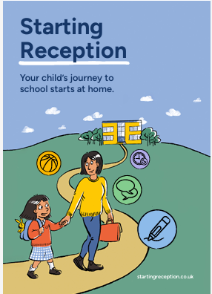
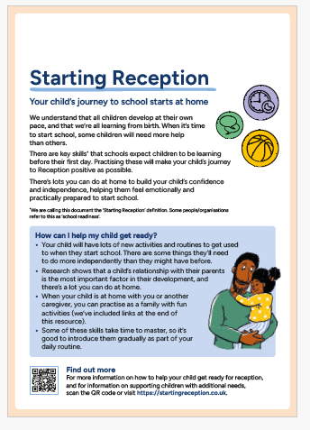
Parental Support and School Readiness
Things you can do to help and support your child with starting school.
All children develop at their own pace, and are all learning from birth. When it’s time to start school, some children will need more help than others. There’s lots you can do at home to build your child’s confidence and independence, helping them feel emotionally and practically prepared to start school.
The Definition: skills to practise before starting Reception
Growing independence
Taking care of themselves
Play, creativity and curiosity
Building relationships and communicating
Being with others
Communication and language
Listening and engaging
Physical development
Getting moving for at least 3 hours a day
Healthy routines
www.stpaulandsttimothys.com
Love, Learn, Believe, Achieve in the Spirit of Jesus

Slide 23

Parental Support and School Readiness
Things you can do to help and support your child with starting our school.
Putting on/taking off their coat and shoes independently
Using the toilet and washing their hands
Getting dressed with little help, e.g. after using the toilet
Using cutlery (e.g. fork and spoon, chopsticks) and drinking
from an open cup
Spending time away from you, learning they can be looked
after by caring adults
Paying attention for short periods of time
Listening to and following simple instructions
Practising sharing and taking turns with toys and waiting
Talking to them about how they are feeling and why
www.stpaulandsttimothys.com
Love, Learn, Believe, Achieve in the Spirit of Jesus

Slide 24
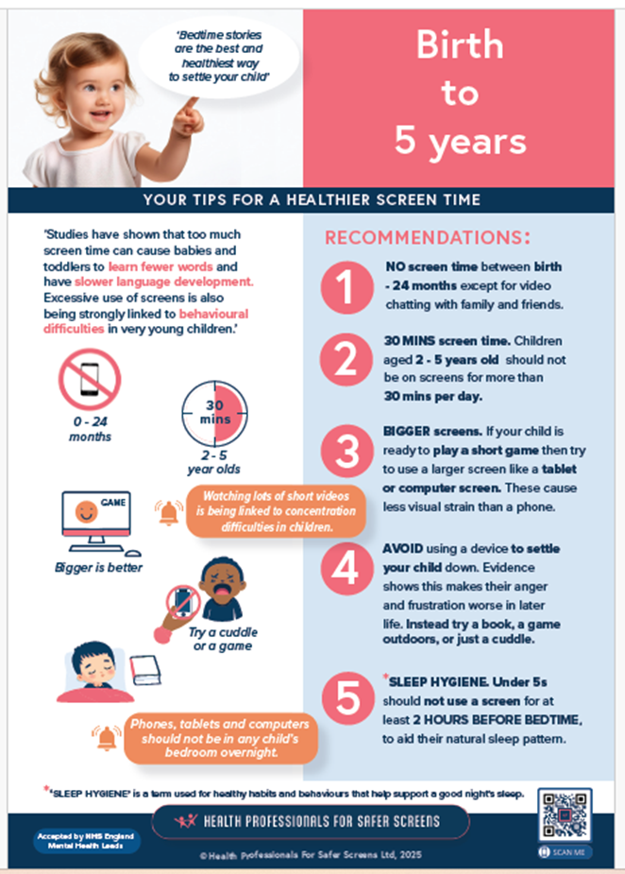
Technology
Latest research and statistics
"The Common Sense Census: Media Use by Kids Age Zero to Eight" Feb 2025 San Francisco
Key findings from the report
  By age 2, 40% of children have their own tablet. Their screen time remains steady at about 2.5 hours per day
  By age 4, more than half (58%) of children have their own tablet.
  About one in five children use mobile devices for emotional regulation, mealtimes, or to fall asleep.
  Fewer parents are co-watching short-form video content like Youtube and Tiktok, despite its rapid-fire and algorithm-driven nature.
Tips for healthier screen time
(Health Professionals for safer screens).
www.stpaulandsttimothys.com
Love, Learn, Believe, Achieve in the Spirit of Jesus

Slide 25

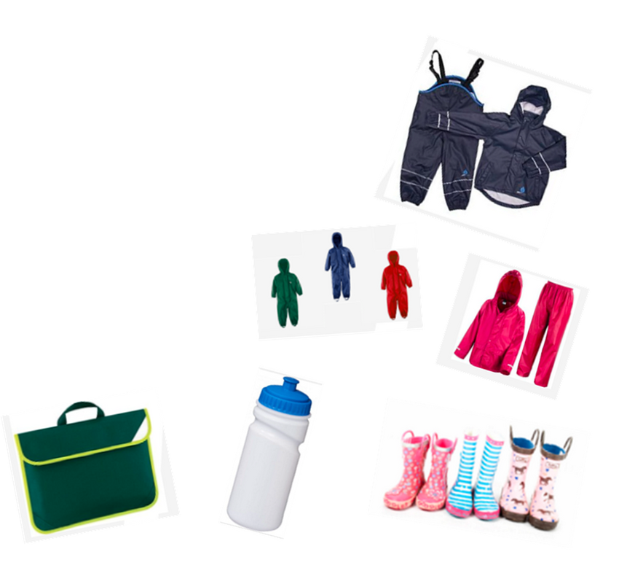
Uniform
Here is a list of what your child needs in September to start school. Any questions please ask a member of staff or look on the school website for more information.
  Bottle green school tracksuit.
  White polo shirt.
  Grey or white school socks.
  Black school shoes or trainers (with velcro if possible so your child can fasten their own shoes).
  Waterproof jacket and pants or all in ones. Any colour.
  Wellies.
  A water bottle.
  Book bag.
www.stpaulandsttimothys.com
Love, Learn, Believe, Achieve in the Spirit of Jesus

Slide 26
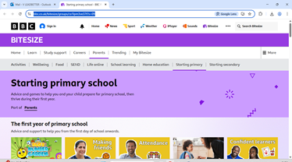
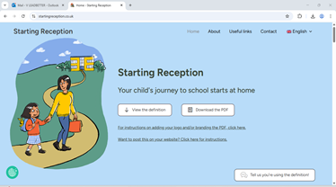
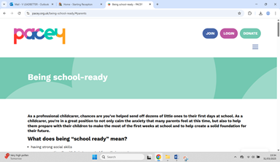
Useful Information and Websites
https://www.bbc.co.uk/bitesize/groups/cx1lpm3ve37t?s=09
https://startingreception.co.uk/
https://www.pacey.org.uk/being-school-ready/#parents
www.stpaulandsttimothys.com
Love, Learn, Believe, Achieve in the Spirit of Jesus

